Slide 1


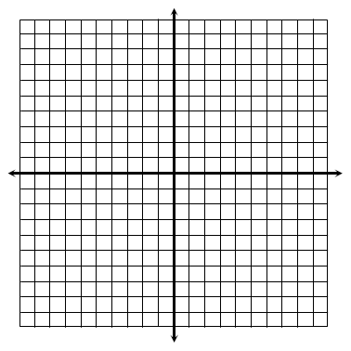
1. Which functions represent an exponential growth? Check all that apply.
Graph each function and identify its key characteristics.
2.
Domain:
Range:
End Behavior:
As , ________
As , ________
y-intercept:
Asymptote:
3.
Domain:
Range:
End Behavior:
As ,
As ,
x-intercept:
Asymptote:
4.
Domain:
Range:
End Behavior:
As ,
As ,
x-intercept:
Asymptote:
© Gina Wilson (All Things Algebra®, LLC), 2015-2023

Slide 2

5. Which line represents the asymptote of the graph of the following function?
6. What is the domain of the function given below?
A. x = -4 B. x = 1 C. y = -4 D. y = 1
A. {x | x > -5} B. {x | x > 5} C. {x | x > -2} D. {x | x > 2}
7. Which is equivalent to the equation given below?
8. Which is equivalent to the equation given below?
A. B. C. D.
A. B. C. D.
9. Which is equivalent to the equation given below?
10. Which is equivalent to the equation given below?
A. B. C. D.
A. B. C. D.
11. The expression is equivalent to which of the following?
12. Find the value of the expression below.
A. 2 B. 6 C. D.
A. 5 B. 7 C. 9 D. 33

Slide 3

13. Approximate the value of to the nearest ten-thousandths place.
14. Which of the following have values less than 1? Check all that apply.
15. Condense the expression below into a single logarithm.
16. Condense the expression below into a single logarithm. Do not evaluate.
17. Which expression is not equivalent to ?
18. Write a value in the box that would make the equation true.
A. B. C. D.
19. Expand the logarithm below.
20. Expand the logarithm below.

Slide 4

21. Which is equivalent to the expression below?
22. Which is equivalent to the expression below?
A. B. C. D.
A. C. B. D.
For questions 23-30, solve each equation. Round to the nearest ten-thousandths place when necessary.
23.
24.
25.
26.
27.
28.

Slide 5

29.
30.
31. Jack bought a new car in 2014 for $28,000. If the value of the car decreases by 14% each year, write an exponential model for the value of the car. Then, estimate the year the car will have a value of $5,000.
Equation:
Answer:
32. Logan inherited $8,000 from his grandmother. He split the money evenly and placed the amounts in the two accounts below. Find the total amount of money he will have in the accounts combined after 5 years.
Account A: earns 7% interest compounded quarterly Account B: earns 5.5% interest compounded annually
Answer:
33. A bacteria culture begins with 500 bacteria and is growing exponentially. The number of bacteria after t hours can be modeled by the function f (t) = 500e^{0.9t}. Find the number of bacteria after 4 hours.
Answer:

Slide 6

34. The table below shows the number of new restaurants in a fast-food chain that opened during the years of 1988 through 1992. Using an exponential model, write an equation for the curve of best fit, then estimate the number of new restaurants that opened in 2005.
Year | New Restaurants
1988 | 49
1989 | 81
1990 | 112
1991 | 150
1992 | 262
Equation:
Answer:
35. The table below shows the water temperature at certain depths of a lake. Using an logarithmic model, write an equation for the curve of best fit, then estimate the depth of water at a temperature of 50° F.
Depth (ft) | Temp (°F)
2 | 86
12 | 78
14 | 75
45 | 71
68 | 68
Equation:
Answer:
36. The population (in thousands) of a town during certain years is given in the table below. Which model would best fit this data: linear, quadratic, or exponential? Choose the model that best fits the data, write an equation to model the data, then predict the approximate population in 2020.
Year | Population
1960 | 50.6
1970 | 55.5
1980 | 64.0
1990 | 80.3
2000 | 102.9
Model:
Equation:
Answer:

